Slide 1
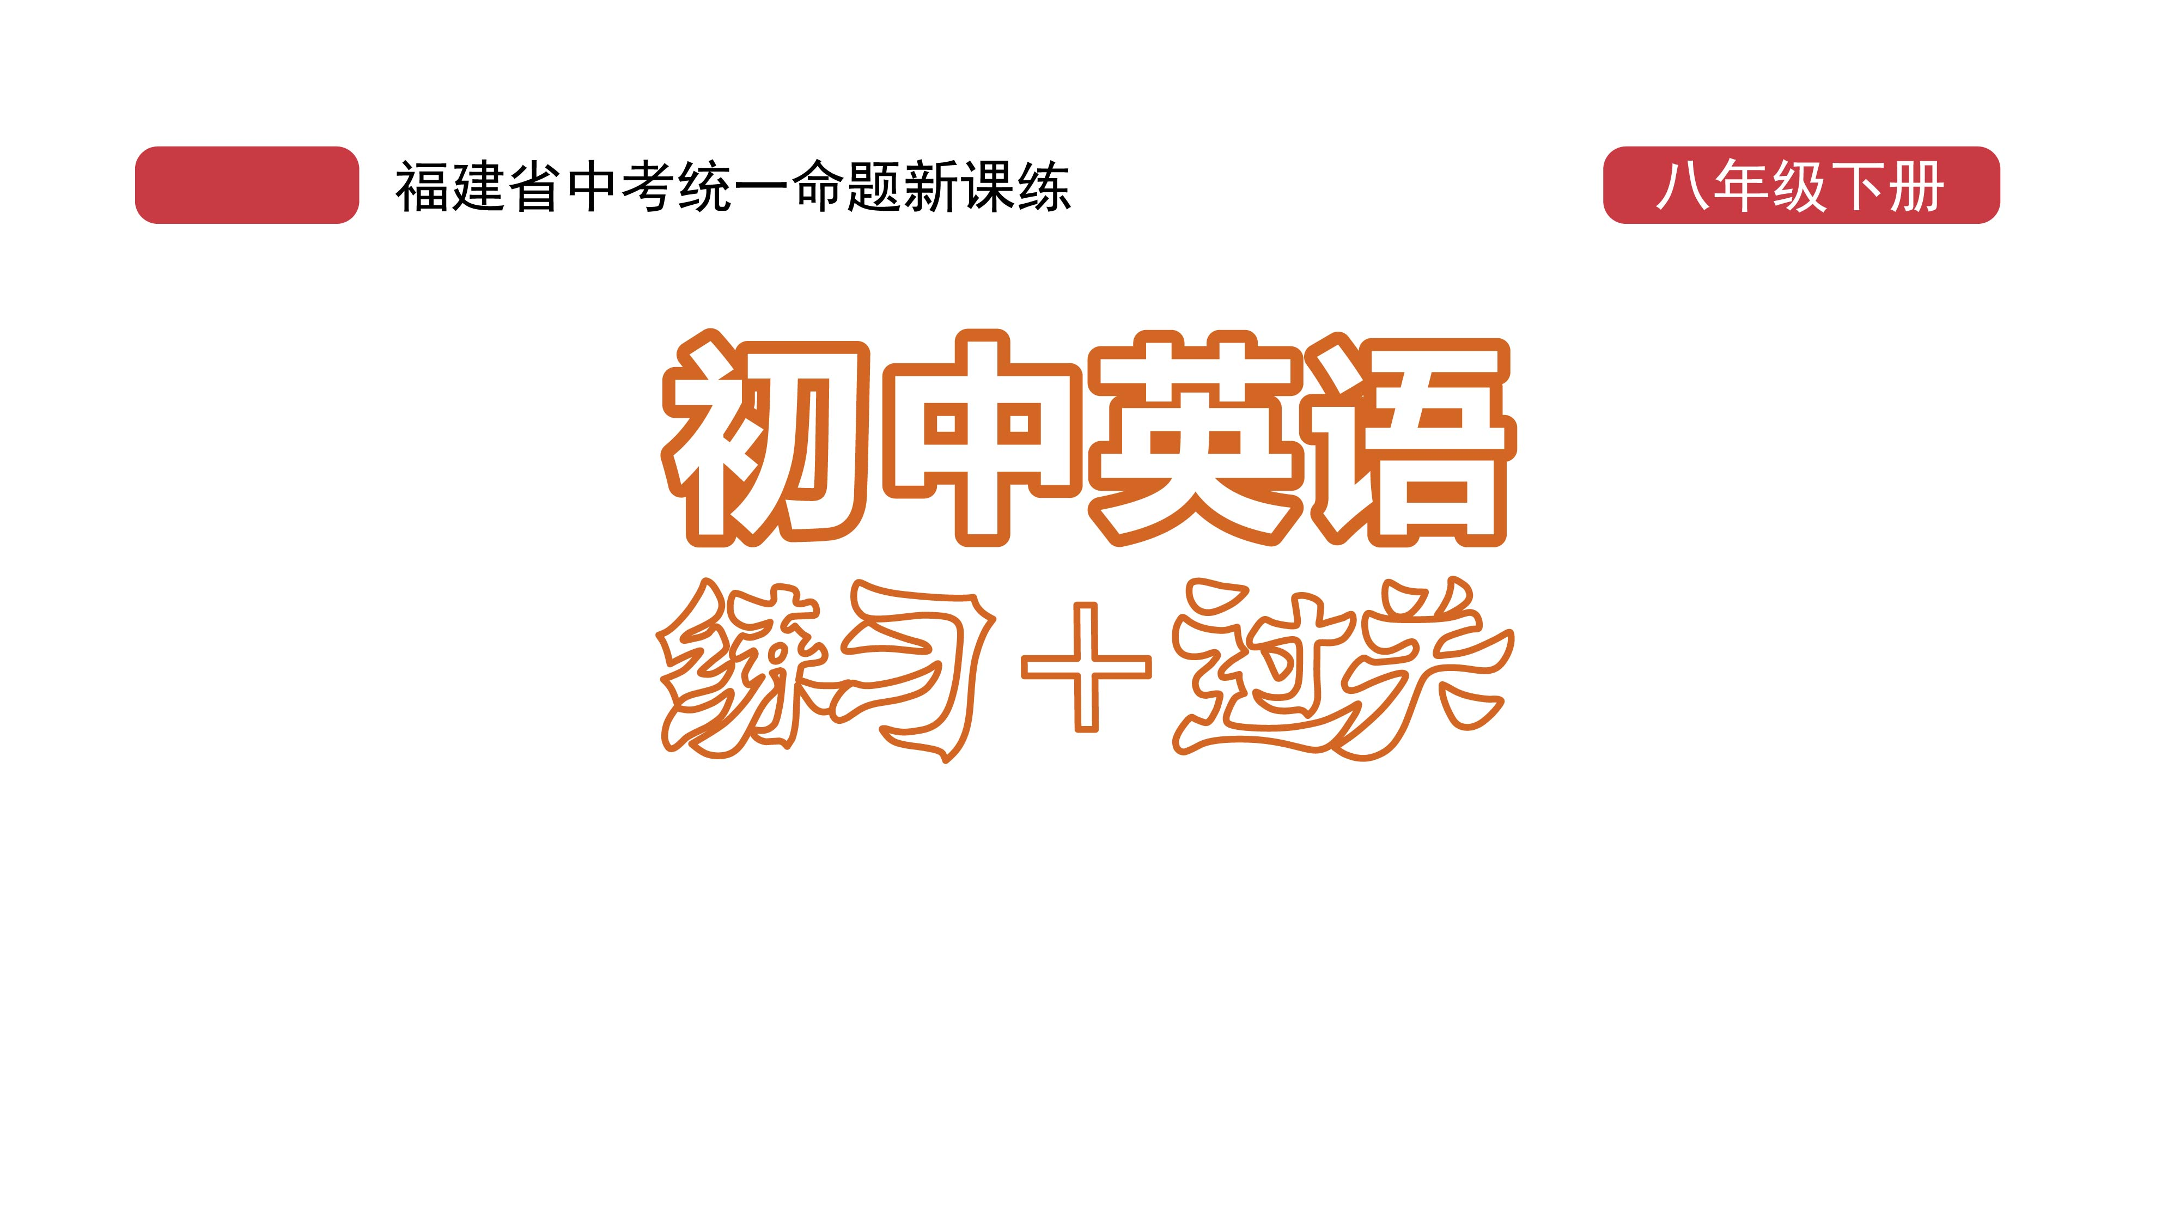
课时练习
模块五 第三章 第三节

Slide 2
一、翻译下列词组。
1. 在中秋节 ____________________________________
2. 和……相聚 __________________________________
3. (使)填满，装满 ______________________________
4. 做某事有困难 ________________________________
5. 明亮地照耀 __________________________________
6. 感觉自信 ____________________________________
on the Mid-Autumn Festival
get together with …
fill with
have trouble/difficulty (in) doing sth.
shine brightly
feel confident

Slide 3
二、根据语境、 音标或所给单词的提示完成句子， 每空一词。
1. The background _______ (noisy) made it hard to hear what he was saying.
2. The disease mostly affects women, ___________ /ɪ'speʃəli/ older women.
3. People should not play music or videos out ______ /laʊd/ on public transport(交通工具).
noise
especially
loud

Slide 4
二、根据语境、 音标或所给单词的提示完成句子， 每空一词。
4. It was two weeks before the Spring Festival and the supermarket was crowded _______ shoppers.
5. In winter, many children have trouble ________ (get) up early in the morning.
with
getting

Slide 5
三、情景交际。
1. 你的心情常被天气影响，你可以这样告诉同学：
The weather ___________________________.
2. 下雨的时候，你总是感到难过，你可以这样向朋友倾诉：
When ________________________________.
often affects my moods
it rains, I always feel sad

Slide 6
三、情景交际。
3. 你想建议朋友遵从他父母的建议，可以这样说：
Why not _____________________________
____________________________________?
follow/take your parents’ advice/ suggestion(s)

Slide 7
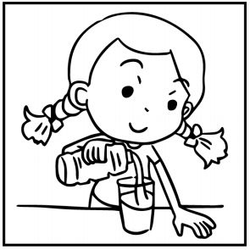
四、看图写话。
1. fill, with
The girl/She fills/filled the glass with water.

Slide 8
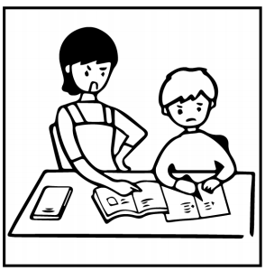
四、看图写话。
2. make, do
The boy’s mother makes him do his homework.

Slide 9
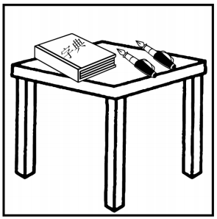
四、看图写话。
3. there be
There is a dictionary and two pens on the desk./
There are two pens and a dictionary on the desk.

Slide 10
五、熟词生义。
1. sense A. n. 感觉；意识 B. vt. 感觉到；察觉到
C. n. 感觉官能 D. n. 意义；含义
_____ (1) Dogs have a strong sense of smell.
_____ (2) He felt a great sense of loss after the failure.
_____ (3) When we read his book, we can sense the sadness in it.
_____ (4) The word “love” is used in different senses by different people.
C
A
B
D

Slide 11
五、熟词生义。
2. trouble A. n. 问题；困难 B. vi. 费神；费心
C. vt. 打扰；麻烦
_____ (1) I’m sorry to trouble you.
_____ (2) Did you have much trouble finding the house?
_____ (3) The lazy man doesn’t trouble to get up to eat.
C
A
B

Slide 12


